Slide 1

Tango by Twine
UX to Design

Slide 2
Detailed Design Planning (1)
Job List
job list icons
Job Embroidery- Normal
Job Embroidery - unreachable
Job Embroidery-with special color
Job Embroidery- gradient
Change color catalog + Twine catalog
Color fine tuning tool
Sample tool
Sewing job- Normal
Printed job (read only)
job progress
Header - general
Header - 4 types of messages
Header- 4 machine states
Header- 4 actions
main menu
cartridge replacement guide+ ink indications
load media guide +edit+load media button
define new media guide- 4 states
icons
Zeplin

Slide 3
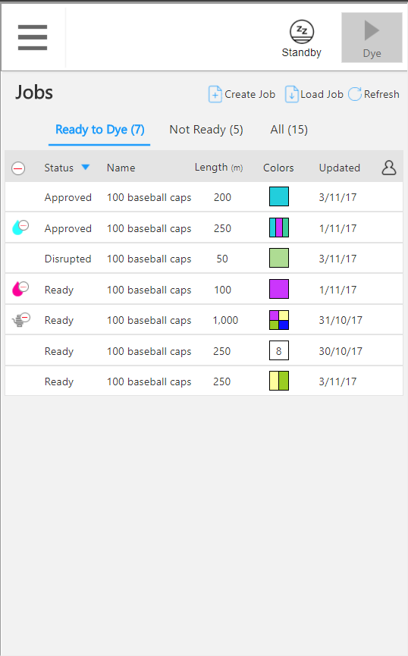
Job List

Slide 4
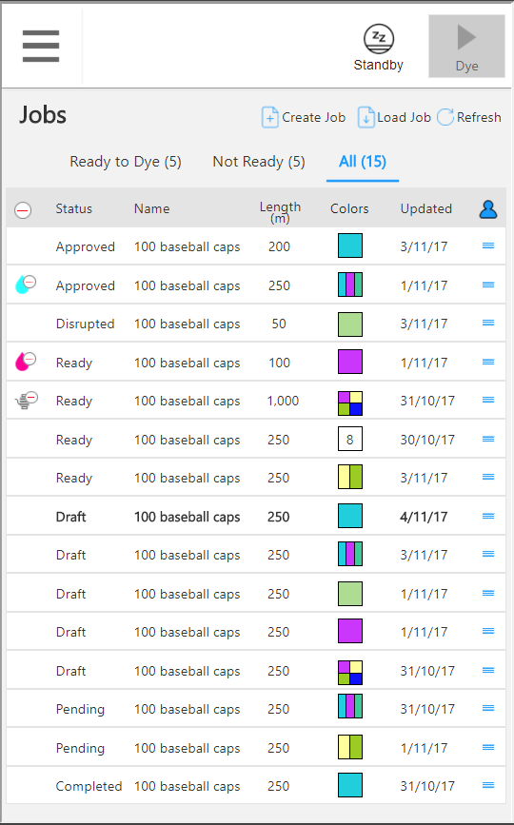
job list icons

Slide 5
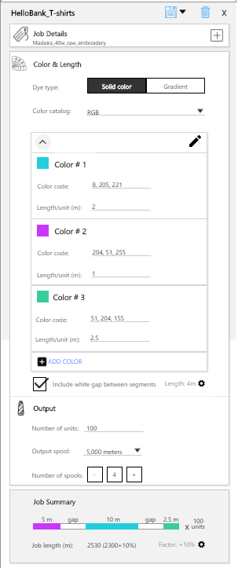
Job Embroidery- solid+gradient

Slide 6
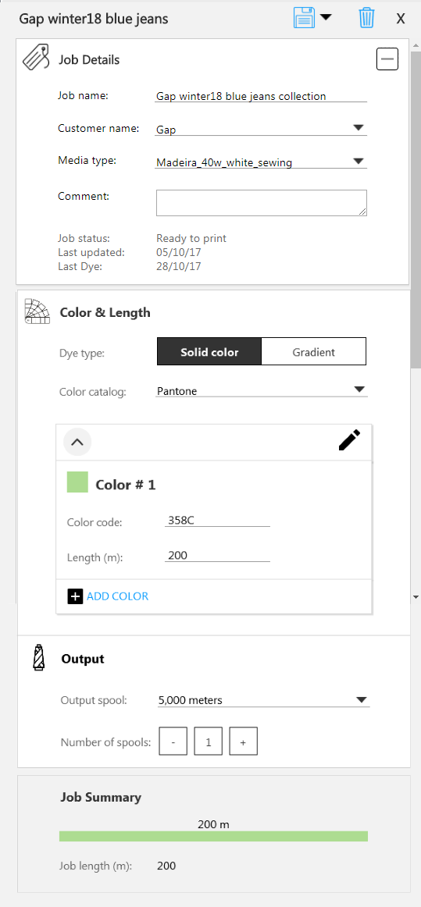
Sewing job- Normal

Slide 7
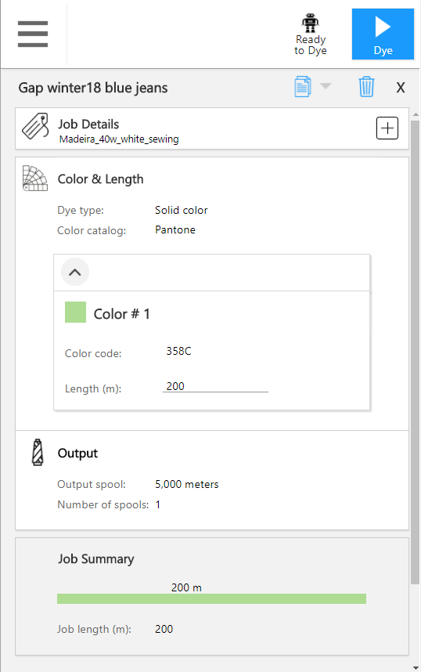
Printed job (read only)

Slide 8
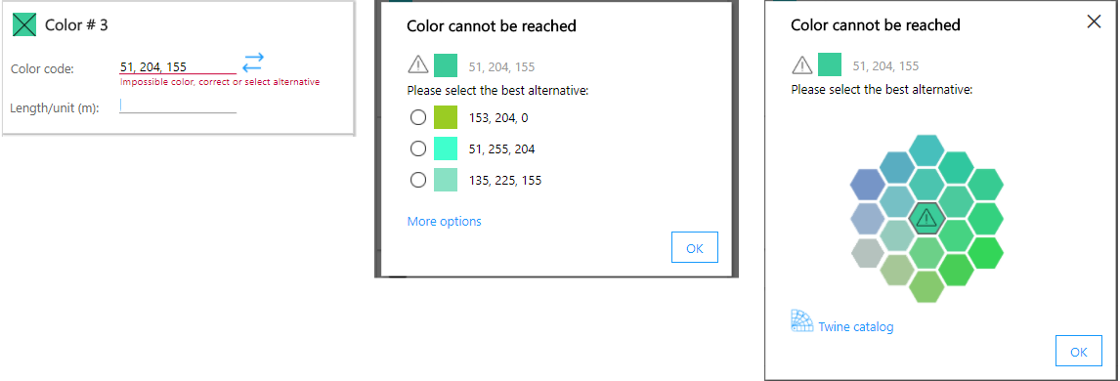
Job Embroidery - unreachable

Slide 9
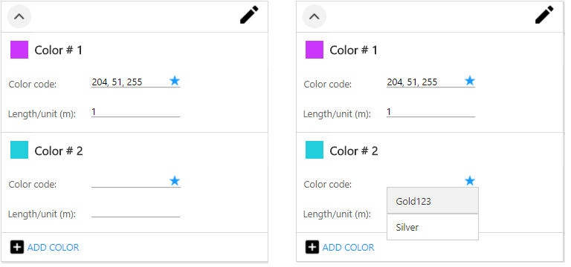
Job Embroidery-with special color

Slide 10
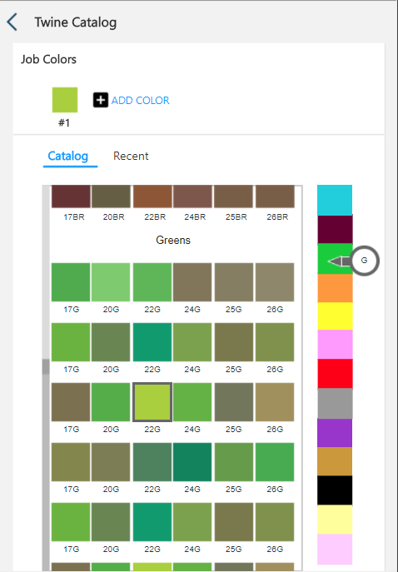
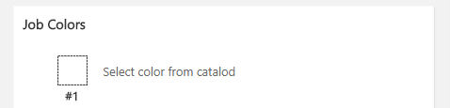
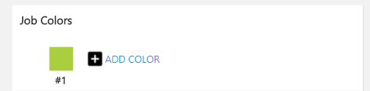
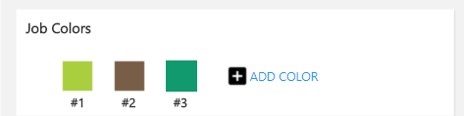
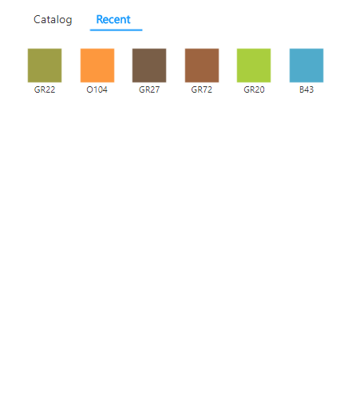
Change color catalog + Twine catalog

Slide 11
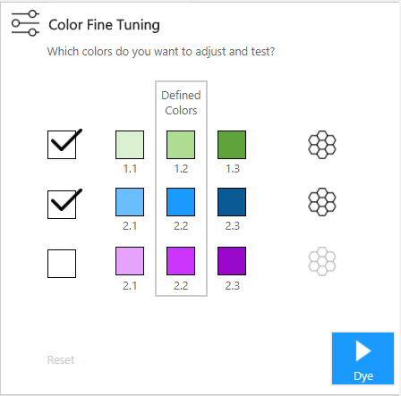
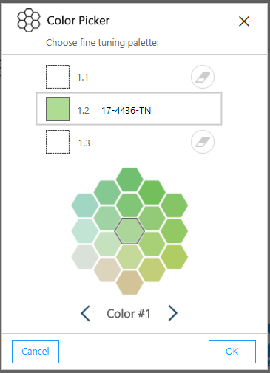
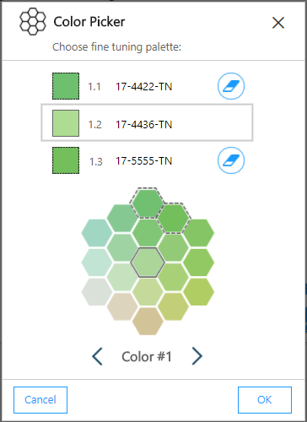
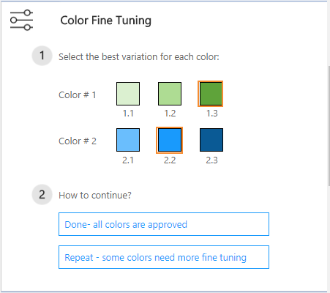
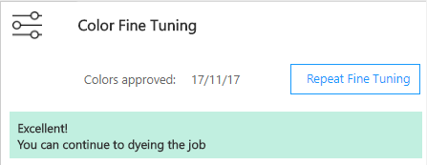
Color fine tuning tool

Slide 12
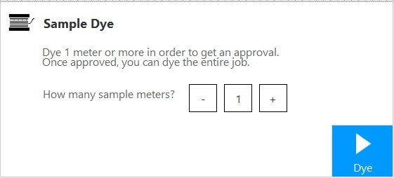
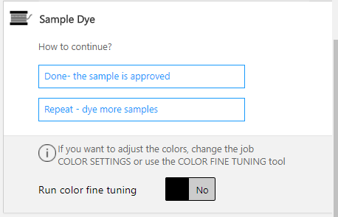

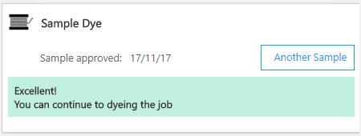
Sample tool

Slide 13

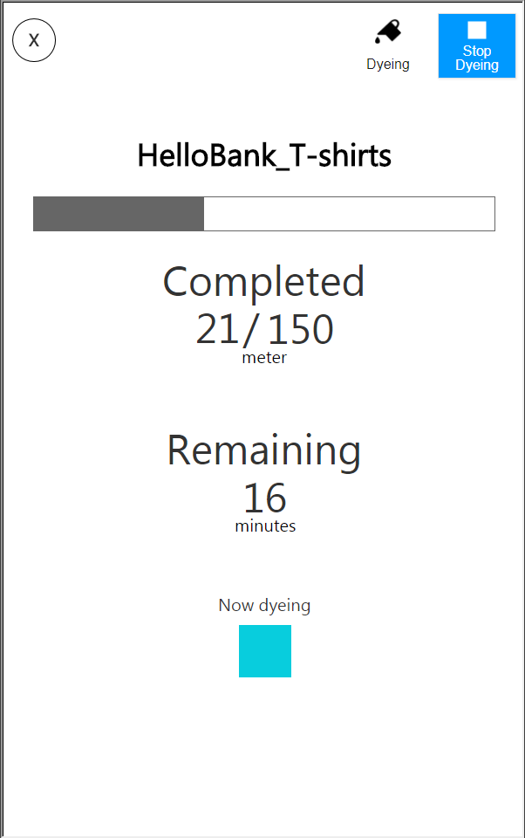
job progress
Normal Job Progress
Full screen Job Progress

Slide 14


Header - general

Slide 15
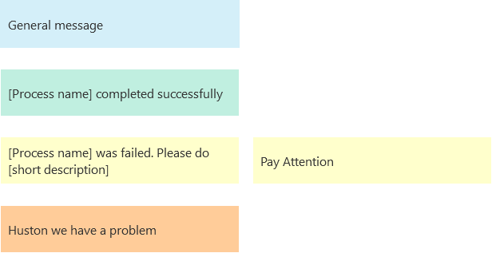
Header - 4 types of messages

Slide 16
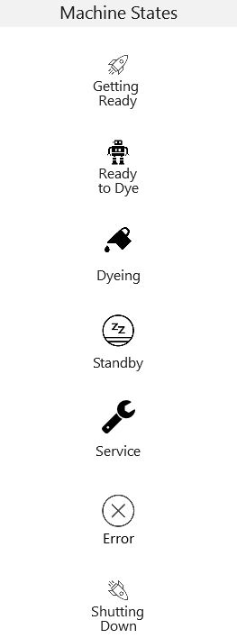
Header- machine states

Slide 17
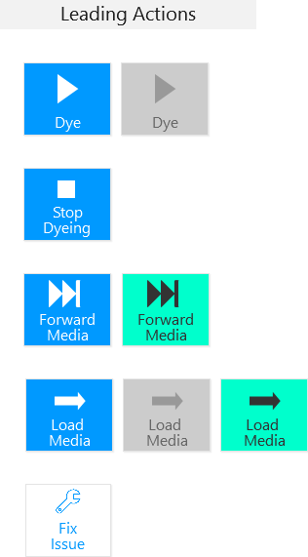
Header- 4 actions

Slide 18
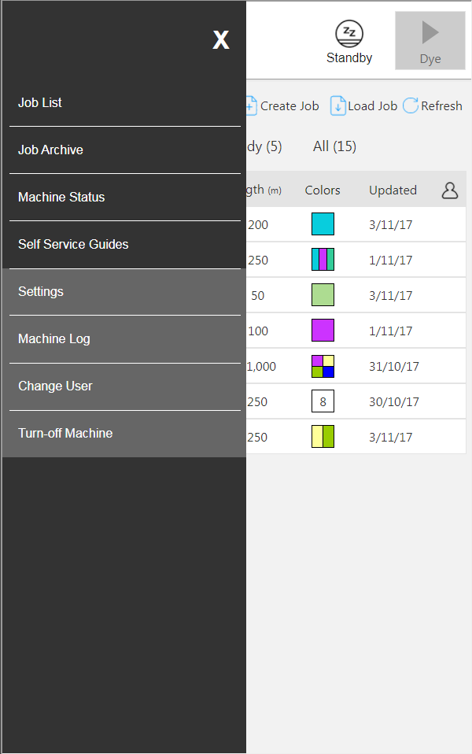
main menu

Slide 19
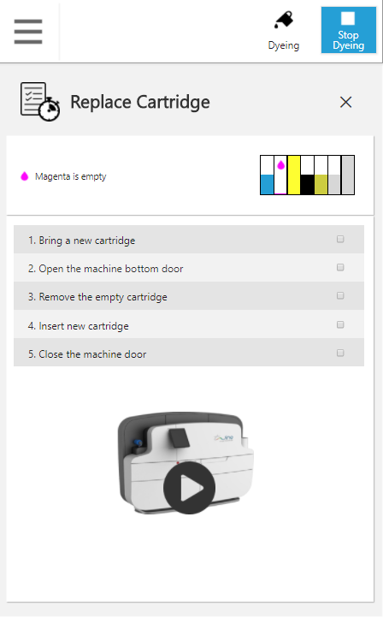
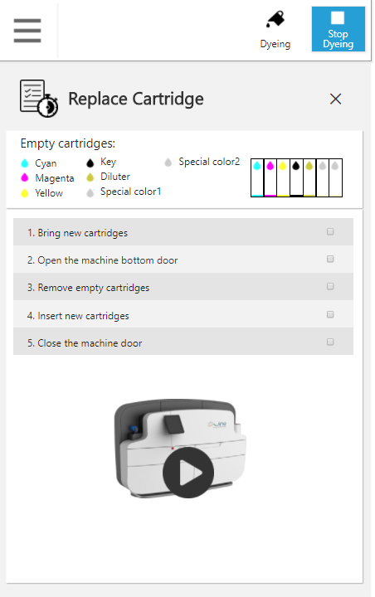
cartridge replacement guide+ ink indications

Slide 20
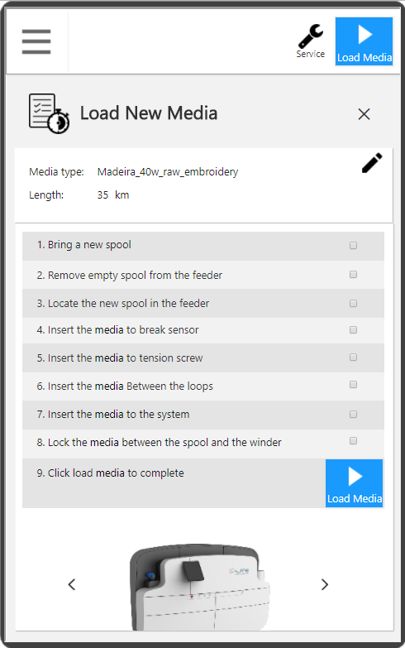
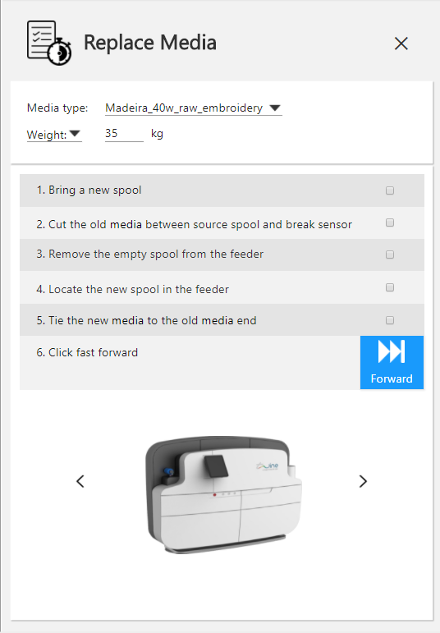
load media guide +edit+load media button

Slide 21
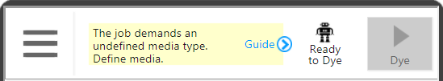
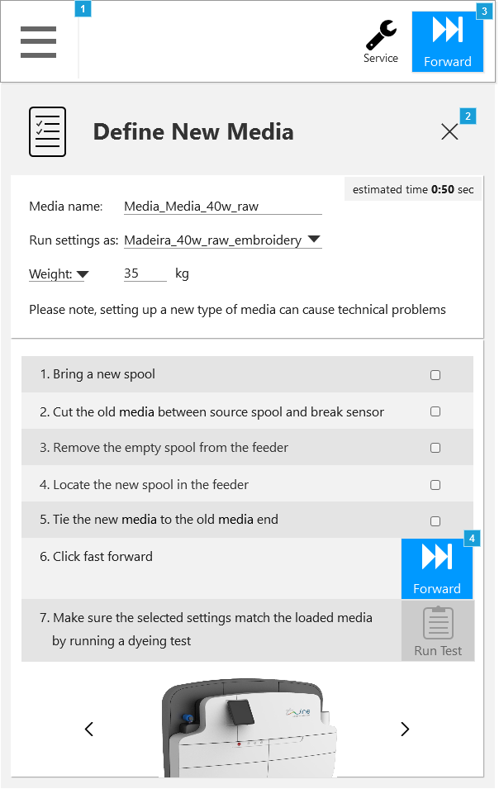
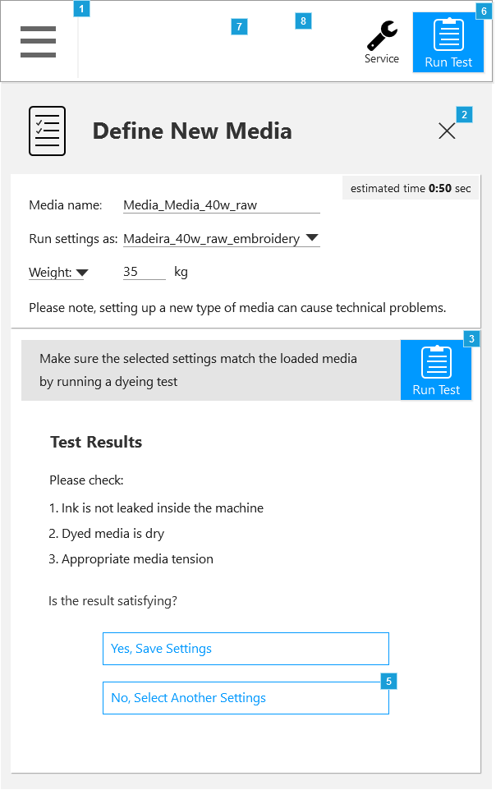
define new media guide- 4 states

